Slide 1
Administrative Data Research Facility

Slide 2
Background
Challenges for research:
Publicly available government data is messy and hard to link across geographic levels
Collaboration between researchers is limited when traditional tools like SAS and STATA are used.
Open source code and tools such as R and Python should be used to make it easier for researchers to collaborate
Our solution:
Create a relational database across geographies by crosswalking data
Databases can either be downloaded on the initial web interface or spun up into the spark social science platform for analysis.
2

Slide 3
Product Details
LINKED DATASETS
Subset of variables from American Community Survey (ACS) and Home Mortgage Disclosure Act (HMDA) linked by geographies
Data Dictionary to define these variables
SPARK SOCIAL SCIENCE PLATFORM
Push button launch of platform from website
Platform includes tutorials, access to linked data and manual
WEB INTERFACE
Basic, open-source website offering download of data/data dictionary and a way to launch the analytics platform
Critical information about the project, including guidance on how to cite linked data
3

Slide 4
Product Details
Linked Datasets
For download
Public Web Interface Project information, links to publications, links to resources.
Data Dictionary
For download
Spark Platform
Button launches platform
Tutorials
Data
4

Slide 5
Creating the linked database

Slide 6
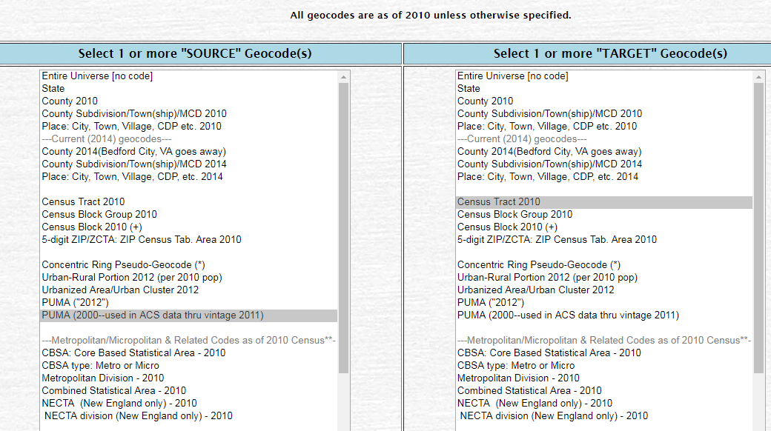
Crosswalk Explanation
We used the Missouri Census Data Center to create crosswalks between different geographic levels
With a given “source” geographic level we specify the “target” geographic level to go from one geographic level to another
For example, to go from PUMA to Census Tract levels for the District of Columbia:
First, we specify that our “source” geographic level is 2010 Census and our “target” geographic level is 2012 PUMA.

Slide 7
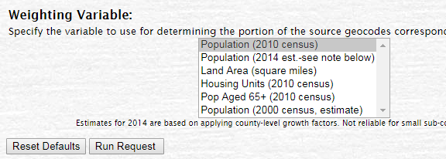
Crosswalk Explanation
Then we used 2010 Census population weighting

Slide 8
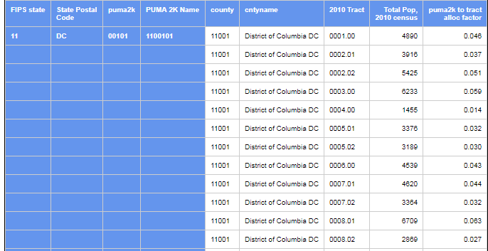
Crosswalk Explanation
Once we specify these geographic levels, we get an output showing the tract to PUMA weighting and allocation factors.
Crosswalk files will be made available on the ADRF website
This example is just for DC, but we used the same process for the whole country

Slide 9
Methodology
We have linked the two datasets on geographic level.
Census Tract
(HMDA)
PUMA
(ACS)
Census Tract 2000 to Census Tract
2010
Census Tract 2000 to PUMA
2010
Census Tract 2010 to Zipcode 2010
PUMA 2010 to CBSA 2013
PUMA 2010 to County 2014
PUMA 2000 to Census Tract
2010
PUMA 2000 to PUMA 2010
If the direct crosswalk is not available from the website, we did some manipulations to create a new crosswalk
6

Slide 10
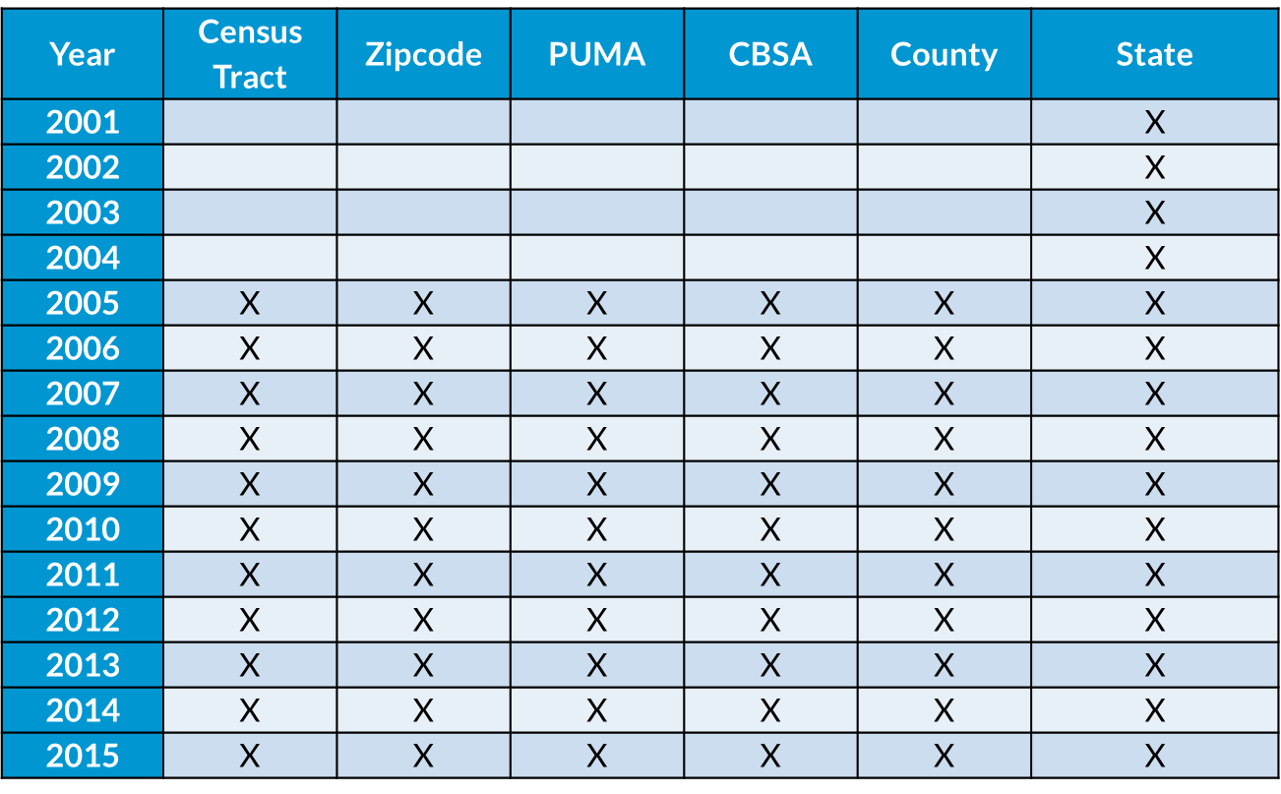
Geographic Levels Available From 2001
There are 6 databases at different geographic levels.
7

Slide 11
How to use the database

Slide 12
Data structure
HMDA Variables
ACS Housing Variables
ACS Household Variables
ACS Person Variables
Agency
Supervisory/regulatory agency of institution
Loan purpose
Purchase, refinance, home improvement
Loan Amount
Mortgage Status
If there is a mortgage owned free and clear
Bedrooms
Number of bedrooms in the house
Monthly Mortgage Payment
Number of families
Number of families in the household
Multiple generations
Number of generations in the household
Household Income
Sex
Whether the respondent is male or female
Grade Attained
Grade or level of recent schooling
Transportation Time (minutes)
In the dataset, we have included both the raw variables from HMDA and ACS, as well as some variables which we constructed
9

Slide 13
Variable Types
Categorical Variables
Variable with codes
Numerical Variables
Mean
Percentiles (P10, P25, P50, P75, P90)
Categorical-Numerical
Categorical-Categorical
Standard deviation
Variable with codes
Mean
10

Slide 14
Variable Name Conventions
It is critical to understand the naming conventions for various codes because we did a lot of crosstabs between variables
We used “_1” “_2”, etc. to indicate the codes for all categorical variables
For constructed variables, we put a number “1” after the variable name to indicate that it is constructed
For variables that are available as both household and personal variables, we indicated the household variables with “_HH” at the end of the variable name
For crosstabs, we listed both variable names and codes together
11

Slide 15
Variable Examples
“PURPOSE_1” from HMDA refers to a loan for home purchase
“PURPOSE_2” refers to a loan for home improvement, and
“PURPOSE_3” refers to loan for refinancing.
“RACE1_W” from ACS refers to a person of Non-Hispanic White ethnicity
RACE1 was created by us from the original dataset. The 5 categories are Non-Hispanic White, Black, Asian, Hispanic, and Other.
“SEX_HH” refers to whether a household head is male or female
“SEX” is available as a personal variable as well
“SEX_1_RACE1_B” is a crosstab that refers to black males
“VALUEH_MORTGAGE_1” is a crosstab that shows the value of housing units for people with mortgages
12

Slide 16
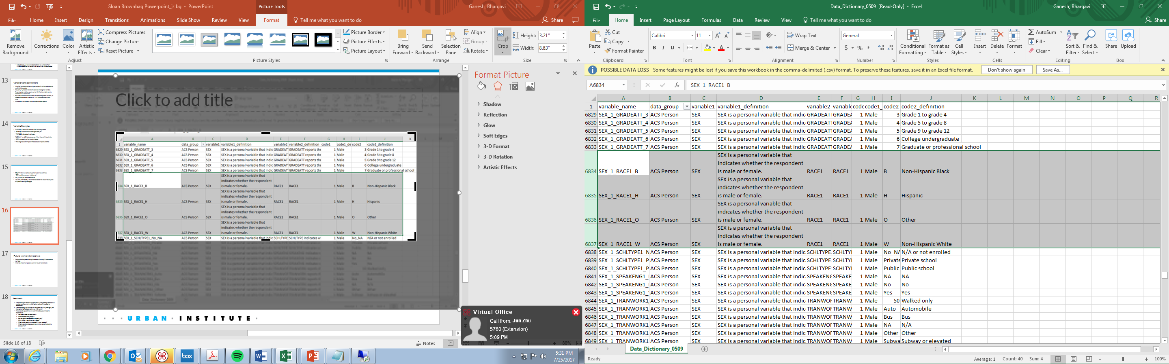
Data Dictionary
We have a detailed data dictionary available which covers all the data types, variables, and definitions
13

Slide 17
Treatment of HMDA Version Change

Slide 18
The treatment of HMDA Database Version Change (State file only)
In 2004, a new HMDA version became available. When we compare the most recent version of HMDA to the pre-2004 version, there are three main changes.
Lien status is added
The definition of agency is changed.
Race field is separated into two fields: Ethnicity and Race.

Slide 19
Agency
The type of purchaser code was slightly different before and after 2004.
Before 2004, a code of “5” represented a commercial bank and a code of “6” represented a savings bank or savings association.
After 2004, a code of “5” represents a private securitization, and a code of “6” represents a commercial bank, savings bank, or savings association.
To treat pre-2004 variables, all variables with a code of “5” need to be re-coded as “6”.

Slide 20
Lien Status
The “lien” variable did not exist before 2004.
After 2004:
“1” represents secured by a first-lien
“2” represents secured by a subordinate lien
“3” represents not secured by a lien
“4” represents not applicable (purchased loans)

Slide 21
Applicant Race
Applicant and co-applicant race determinations changed in 2004
HMDA now reports both race and ethnicity. To convert the pre-2004 variables to the new version, the following steps need to be taken:
All pre- 2004 race variables with a code of “1” need to be re-coded as having a race of “1” and an ethnicity of “2”
All pre-2004 race variables with a code of “2” need to be re-coded as having a race of “2” and ethnicity of “2”
All pre-2004 race variables with a code of “3” need to be re-coded as having a race of “3” and ethnicity of “2”
All pre-2004 race variables with a code of “4” need to be re-coded as having a race of “7” and ethnicity of “1”

Slide 22
Applicant Race
All pre-2004 race variables with a code of “5” need to be re-coded as having a race of “5” and ethnicity of “2”
All pre-2004 race variables with a code of “6” need to be re-coded as having a race of “6” and ethnicity of “2”
All pre-2004 race variables with a code of “7” need to be re-coded as having a race of “6” and ethnicity of “3”
All pre-2004 race variables with a code of “8” need to be re-coded as having a race of “7” and ethnicity of “4”

Slide 23
Co-Applicant Race
Like the race variable, HMDA now reports both race and ethnicity for the co-applicant variable as well.
To convert the pre-2004 variables to the new version, the following steps need to be taken:
All pre- 2004 co-applicant race variables with a code of “1” need to be re-coded as having a race of “1” and an ethnicity of “2”
All pre-2004 co-applicant race variables with a code of “2” need to be re-coded as having a race of “2” and ethnicity of “2”
All pre-2004 co-applicant race variables with a code of “3” need to be re-coded as having a race of “3” and ethnicity of “2”
All pre-2004 co-applicant race variables with a code of “4” need to be re-coded as having a race of “7” and ethnicity of “1”

Slide 24
Co-Applicant Race
All pre-2004 co-applicant race variables with a code of “5” need to be re-coded as having a race of “5” and ethnicity of “2”
All pre-2004 co-applicant race variables with a code of “6” need to be re-coded as having a race of “6” and ethnicity of “2”
All pre-2004 co-applicant race variables with a code of “7” need to be re-coded as having a race of “6” and ethnicity of “3”
All pre-2004 co-applicant race variables with a code of “8” need to be re-coded as having a race of “7” and ethnicity of “4”

Slide 25
Loan Purpose and Property Type
Before 2004, loan purpose was combined with property type: “1” represented home purchase loans that are 1-4 family, “2” represented a home improvement for 1-4 family, “3” represented refinancing for 1-4 family, and “4” represented multifamily dwellings (home purchase, home improvement, and refinancings)
After 2004, loan purpose and property type were separate. A property type of “1” represented 1-4 family, a property type of “2” represented manufactured housing, and a property type of “3” represented multifamily. A loan purpose of “1” represents home purchase, a loan purpose of “2” represents home improvement, and a loan purpose of “3” represents a refinancing.

Slide 26
Loan Purpose and Property Type
To treat pre-2004 variables, the following steps need to be taken:
All pre-2004 loan purpose variables with a code of “1” need to be re-coded as having a property type “1” and loan purpose of “1”.
All pre-2004 loan purpose variables with a code of “2” need to be re-coded as having a property type of “1” and a loan purpose of “2”.
All pre-2004 loan purpose variables with a code of “3” need to be re-coded as having a property type of “1” and a loan purpose of “3”
All pre-2004 loan purpose variables with a code of “4” need to be re-coded as having a property type of “3” and a loan purpose of “N/A” since it is unclear whether they have a loan purpose of “1”, “2”, or “3”.

Slide 27
What states are available?

Slide 28
State level
The combined HMDA-ACS does not have Puerto Rico. However, Puerto Rico (FIPS Code 72) is available in the individual HMDA file.

Slide 29
Use the Sloan Website and Spark

Slide 30
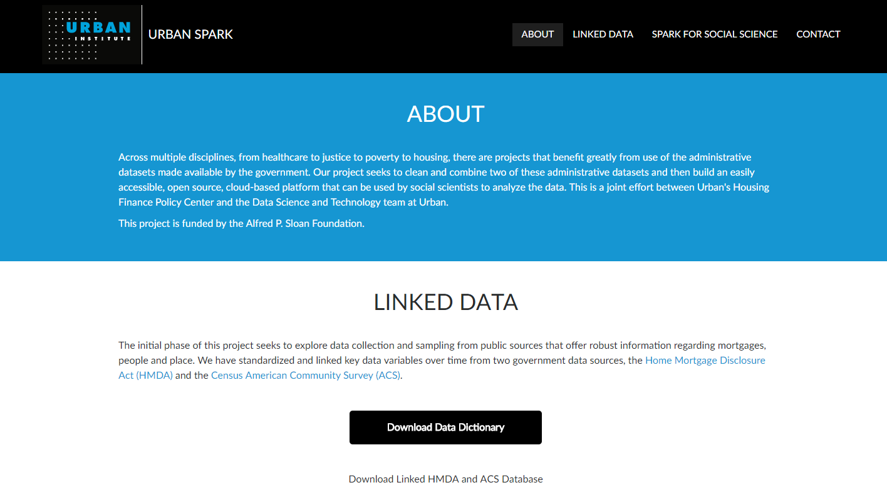
Sloan Website
https://adrf.urban.org/
Screenshot of the website
Linked data is available in CSV, SAS and STATA formats
Data can also be analyzed in the Spark for Social Science platform

Slide 31
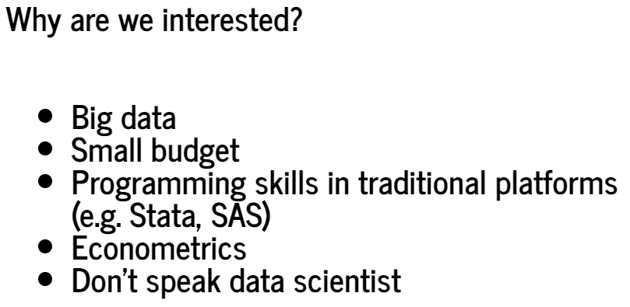
Spark

Slide 32
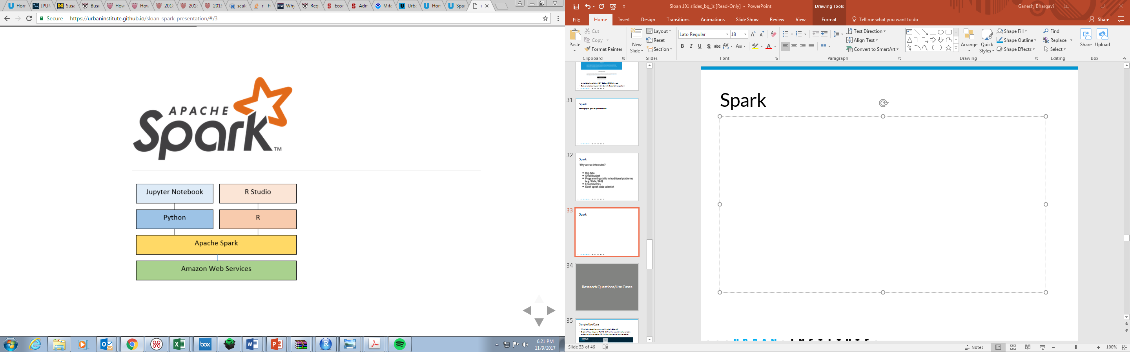
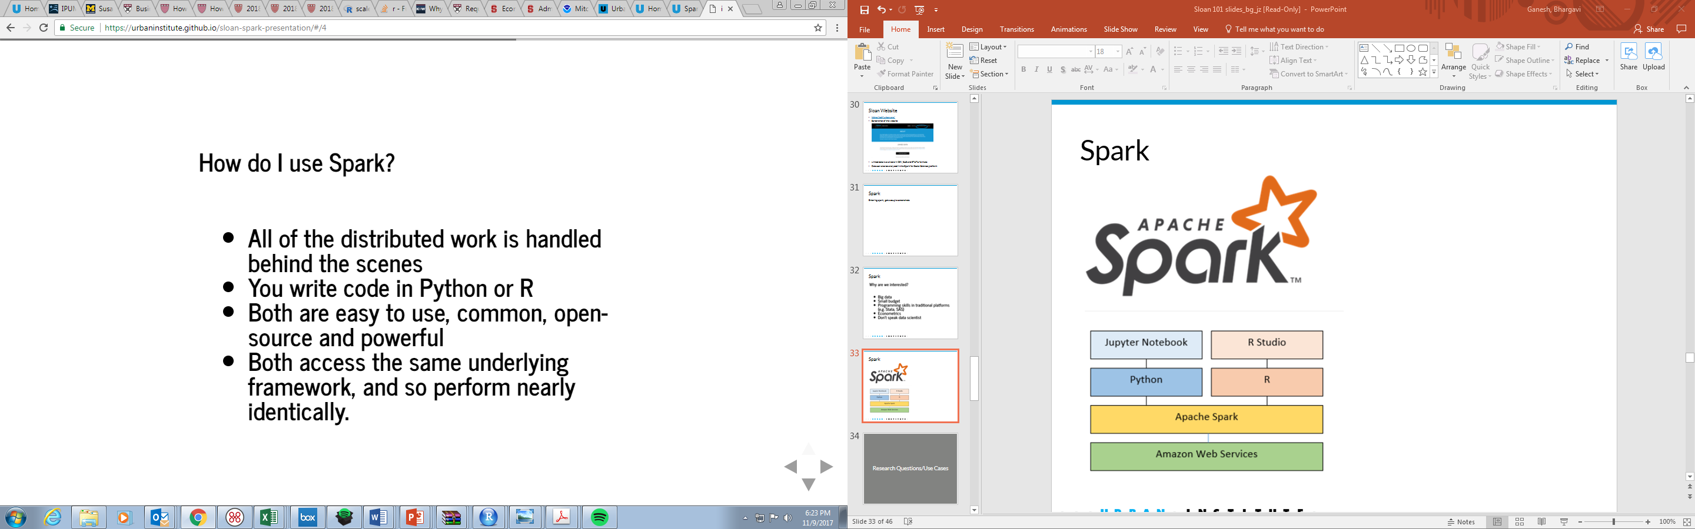
Spark

Slide 33
Research Questions/Use Cases

Slide 34
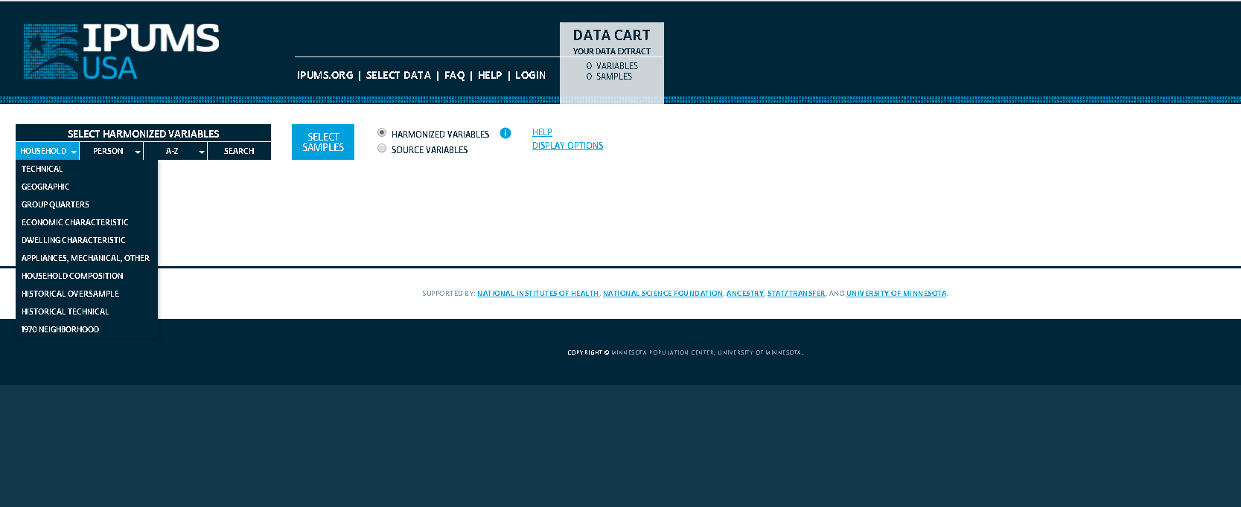
Sample Use Case
What is the black homeownership rate in Atlanta?
Original Way: (1) go to IPUMS. (2) find the race/ethnicity variable and ownership variables. (3) find the geographic level variables.
15

Slide 35
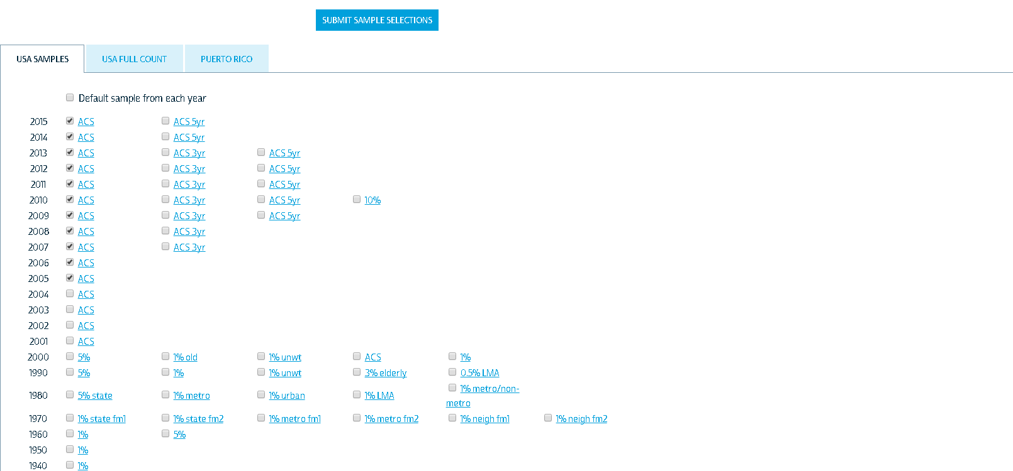
Answer This Question using IPUMS
Pick the years.
Search for the crosswalk (PUMA 2000 to PUMA 2010)
Calculate the total households and homeowners using crosswalk
16

Slide 36
Or with the ADRF
3 Simple Steps:
Use the CBSA database
Search for CBSA (12060) for Atlanta
Find the cross tab variable: race1_HH_B_ownership_1 and single categorical variable: race1_HH_B
Year | HH_Black | Owner_Black | Black homeownership rate
2005 | 532,991 | 271,159 | 50.9%
2006 | 546,690 | 288,162 | 52.7%
2007 | 567,361 | 309,523 | 54.6%
2008 | 572,848 | 308,427 | 53.8%
2009 | 566,727 | 298,689 | 52.7%
2010 | 602,219 | 311,240 | 51.7%
2011 | 610,884 | 305,327 | 50.0%
2012 | 619,959 | 299,822 | 48.4%
2013 | 631,399 | 296,475 | 47.0%
2014 | 643,395 | 305,015 | 47.4%
2015 | 660,484 | 303,386 | 45.9%
17

Slide 37
Supply-Demand Gap Question
Do we have a housing demand-supply gap in certain areas?
Does the gap place upward pressure on both home prices and rents?
Sloan Database
Household numbers
Average rent
Census
Housing Units
CoreLogic
Housing Price Index
Average household income
18

Slide 38
Supply-Demand Gap Results by County
Directly use county level database to get total households numbers, average rent, and average household income from 2010 to 2015.
Crosswalks needed: PUMA 2000 to PUMA 2010 and PUMA 2010 to County 2014.
County Name | Cumulative Demand | Cumulative Supply | 2010-2015 Gap | 2010 # of Households | Household percentage 2010 | Price 2010-2015 | Rent 2010-2015 | Income 2010-2015
Los Angeles County, Califo | 90,739 | 57,689 | 33,050 | 3,202,011 | 1.0% | 39.5% | 12.2% | 15.4%
Cook County, Illinois | 32,523 | -1,428 | 33,951 | 1,922,184 | 1.8% | 11.0% | 13.8% | 21.2%
Harris County, Texas | 188,363 | 118,568 | 69,795 | 1,395,214 | 5.0% | 34.8% | 18.6% | 18.7%
Maricopa County, Arizona | 96,054 | 51,675 | 44,379 | 1,384,276 | 3.2% | 43.0% | 12.0% | 16.3%
San Diego County, Californ | 52,373 | 28,997 | 23,376 | 1,061,237 | 2.2% | 32.5% | 15.2% | 13.5%
Orange County, California | 36,293 | 31,630 | 4,663 | 986,248 | 0.5% | 30.0% | 14.5% | 15.8%
Kings County, New York | 34,857 | 23,255 | 11,602 | 905,317 | 1.3% | 49.0% | 21.6% | 24.3%
Dallas County, Texas | 61,940 | 41,739 | 20,201 | 843,309 | 2.4% | 33.3% | 14.4% | 18.8%
Miami-Dade County, Florida | 46,939 | 21,144 | 25,795 | 813,884 | 3.2% | 50.2% | 17.2% | 14.4%
King County, Washington | 58,362 | 41,499 | 16,863 | 787,758 | 2.1% | 29.3% | 22.1% | 26.9%
Queens County, New York | 2,390 | 13,652 | -11,262 | 772,334 | -1.5% | 24.0% | 13.0% | 16.0%
New York County, New York | 25,153 | 22,010 | 3,143 | 726,090 | 0.4% | 34.0% | 18.4% | 18.3%
Clark County, Nevada | 41,907 | 30,374 | 11,533 | 699,059 | 1.6% | 40.6% | 3.7% | 8.7%
Riverside County, Californ | 44,744 | 25,069 | 19,675 | 669,984 | 2.9% | 41.6% | 11.4% | 13.5%
Tarrant County, Texas | 29,939 | 31,457 | -1,518 | 655,505 | -0.2% | 27.2% | 21.5% | 22.3%
Broward County, Florida | 15,883 | 8,268 | 7,615 | 657,987 | 1.2% | 40.0% | 14.0% | 13.5%
Wayne County, Michigan | -7,629 | -6,837 | -792 | 675,041 | -0.1% | 48.1% | 5.8% | 12.6%
19

Slide 39

Developing a Housing Affordability Index
A New housing affordability index
How many renters earn as much income as an owner who just purchased a 1-4 unit home in the same area?
Renter income: ACS; Borrower income: HMDA
$$\sum_{A=low}^{High}{N×P_{A}×Q_{A}}$$
PA= Likelihood that a renter’s income falls in a specific income level A
QA= Likelihood that a renter’s income is enough to get a mortgage and purchase a home, given his/her specific income level A
20

Slide 40
Affordability Index Inputs Using ADRF
Income Level | P_{A} | Q_{A} | P_{A}*Q_{A}
1 | 2.07 | 0.00 | 0.00
2 | 9.15 | 0.00 | 0.00
3 | 8.91 | 0.78 | 0.07
4 | 13.83 | 2.13 | 0.29
5 | 9.51 | 7.56 | 0.72
6 | 8.43 | 16.86 | 1.42
… | … | … | …
16 | 6.33 | 87.40 | 5.53
17 | 0.00 | 89.53 | 0.00
18 | 2.56 | 91.47 | 2.34
19 | 0.00 | 93.22 | 0.00
20 | 0.00 | 93.99 | 0.00
21 | 0.00 | 95.54 | 0.00
22 | 0.00 | 100.0 | 0.00
21

Slide 41
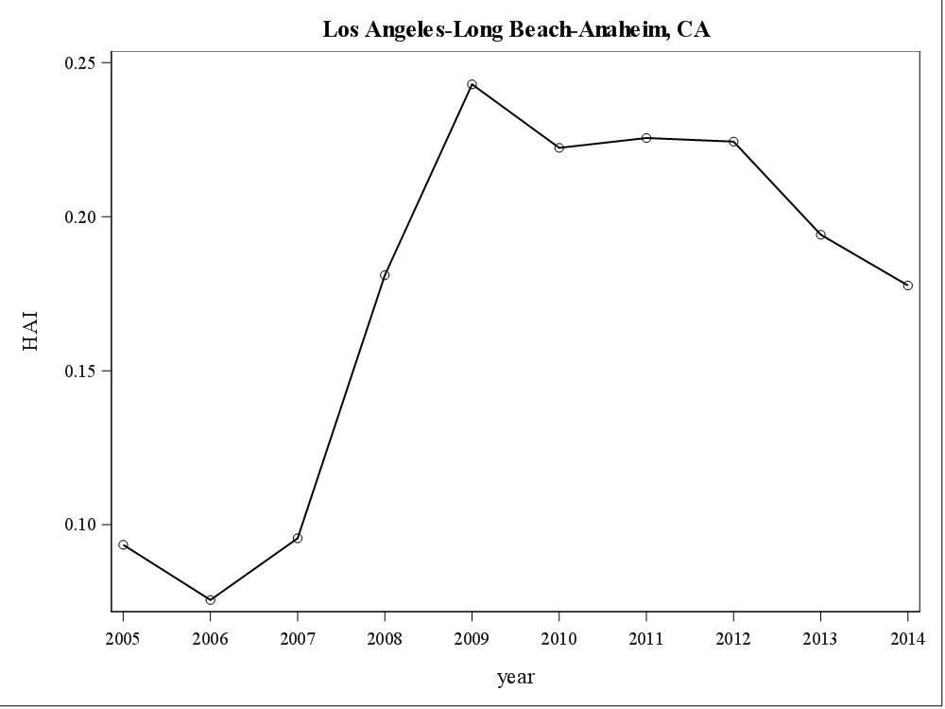
Affordability Index Using ADRF
22

Slide 42
Using the database for empirical studies
Different geographic level variables can be easily added in the regressions to control the local market conditions.
Unemployment rate by race at county level
Percentage of minority population at zipcode level
Average mortgage borrower income at census tract level
Average loan amount at CBSA level
23

Slide 43
Tell us what you think!

